Slide 1
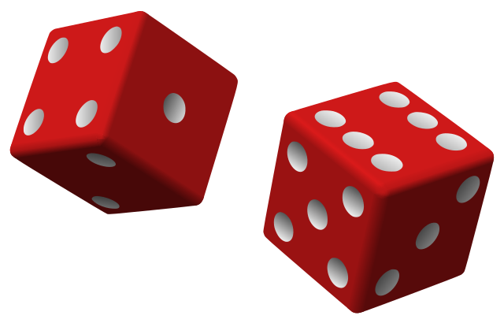
Research Topic
Evaluating The Predictability Of Pseudo-Random Number Generators Using Supervised Machine Learning Algorithms
Master’s Thesis Presented by: Apprey-Hermann Joseph Kwame
April 27, 2020

Slide 2
Introduction
Random number generation is a key component in many computing systems
Games
Gambling systems
Security systems
Problem: Most systems use pseudo-random number generation (PRNG) algorithms
Not truly random processes
Generated from seed (which may be truly random)

Slide 3
Introduction
Cont.
Machine Learning (ML) algorithms predict future occurrences from past experiences
Model of process created from training set of supervised examples
ML algorithms include:
Linear regression
Artificial neural networks
Recurrence algorithms
…

Slide 4
Research Questions
Can ML learn from a seed or a sequence of PRNG random numbers and make predictions about future values?
How accurate is the predictability of ML on certain PRNG?

Slide 5
Previous Work
F. Fan and G. Wang (2018), "Learning From Pseudo-Randomness With an Artificial Neural Network–Does God Play Pseudo-Dice?," in IEEE Access, vol. 6, pp. 22987-22992, 2018.
Petr Savicky & Marko Robnik-Šikonja (2008), Learning Random Numbers: A MATLAB Anomaly, Applied Artificial Intelligence, 22:3, 254-265, DOI: 10.1080/08839510701768382
Neither experiments with PRNG used in programming languages or with same learning algorithms.

Slide 6
Experimental Setup
C++, Python and Java
Lineal regression Model
Neural Network Model
Rattle application of the r framework

Slide 7
Data Collection
Languages and methods tested:
C++
srand() and rand();
Python
Random() and seed();
Java
random() and setSeed()

Slide 8
Experimental Setup
Sample dataset
X | Y
0 | 1
1 | 5
2 | 9
4 | 13
6 | 17
8 | 21
10 | 25
Linear regression Model training process
Stages
Assumes a relationship
Y = B0 + B1*X
Calculate the Error = P(Y) - A(Y)
Update/adjust the B0 and B1 to reduce the error

Slide 9
Experimental Setup
Comparing LM and NNM
x
B0 + B1X
y
Y = B0 + B1*X
Output layer
Input layer
Hidden layer
bias

Slide 10
Experimental Setup
Neural Network Model
10 nodes as used in this work
X
Y
Hidden layer
Output layer
Input layer

Slide 11
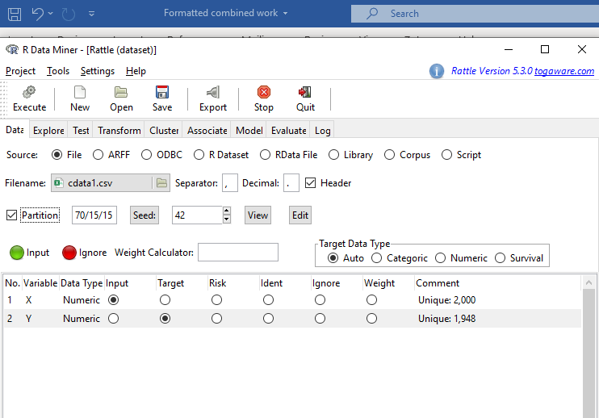
Experimental Setup
Rattle Package of R application
Great GUI
Limitations
No option for activation functions,
Weights etc.

Slide 12
Data Collection
Cont.
Two datasets generated for each language
Same seed used for all random values X_{n} Independent variable: Previous random number in sequence X_{n-1}
New seed generated before each random X_{n} Independent variable: Seed

Slide 13
Data Collection
Cont.
Data Structure
Tables with two columns labeled X and Y.
X - independent variables ie seed / sequence
Y - dependent variable random numbers
Total of 6 tables.

Slide 14
Data Collection
Cont.
Each dataset contained 2000 observations
70% used for training
15% for validation during learning
15% for testing

Slide 15
Data Collection
Cont.
Dataset | Programing language | Independent variables
Dataset 1 | C++ | sequence
Dataset 2 | C++ | seed
Dataset 3 | Python | sequence
Dataset 4 | Python | seed
Dataset 5 | Java | sequence
Dataset 6 | Java | seed

Slide 16
Data Analysis
Cont.

Slide 17
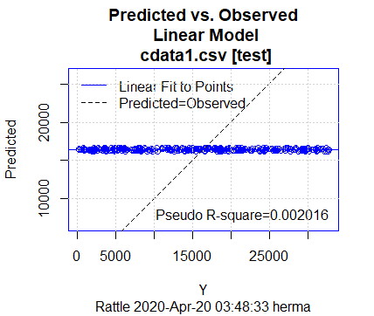
Results and Discussions
Linear Model
performance on Dataset 1

Slide 18
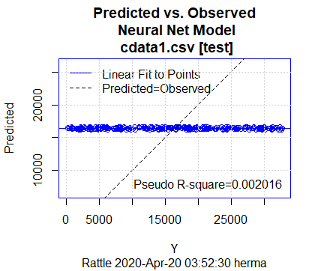
Results and Discussions
Neural Network Model performance on Dataset 1

Slide 19
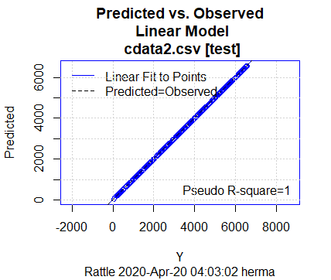
Results and Discussions
Linear Model performance on Dataset 2
R-Square of 1

Slide 20
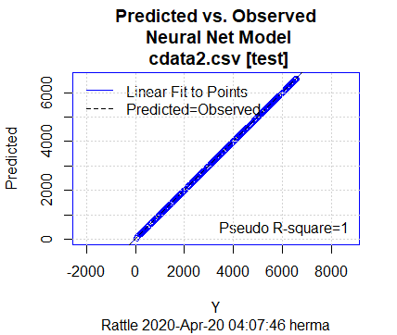
Results and Discussions
Neural Network Model performance on Dataset 2
R-Square of 1

Slide 21
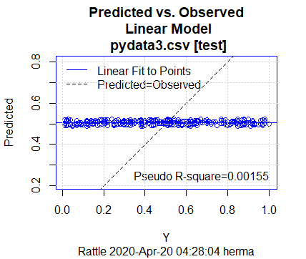
Results and Discussions
Linear Model performance on Dataset 3

Slide 22
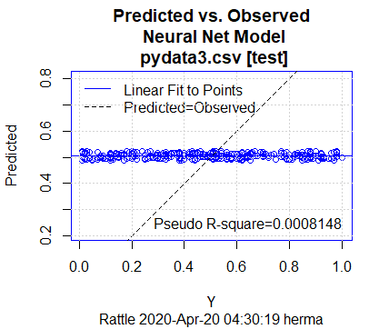
Results and Discussions
Neural Network Model performance on Dataset 3

Slide 23
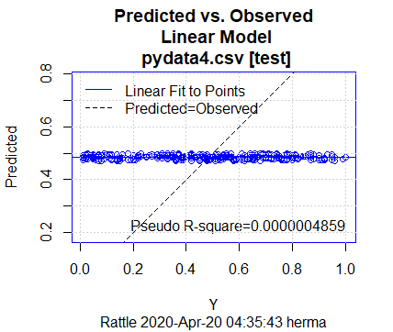
Results and Discussions
Linear Model performance on Dataset 4
The least R-Square

Slide 24
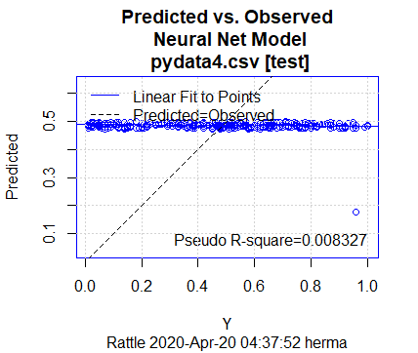
Results and Discussions
Neural Network Model performance on Dataset 4

Slide 25
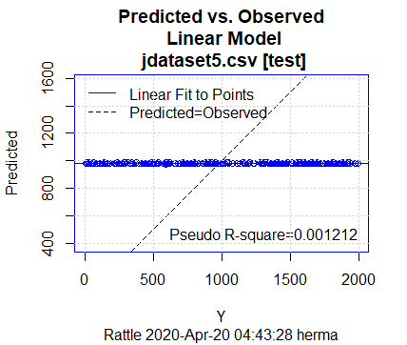
Results and Discussions
Linear Model performance on Dataset 5

Slide 26
Results and Discussions
Neural Network Model performance on Dataset 5

Slide 27
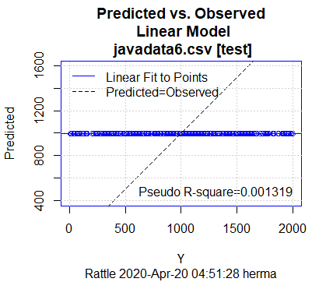
Results and Discussions
Linear Model performance on Dataset 6

Slide 28
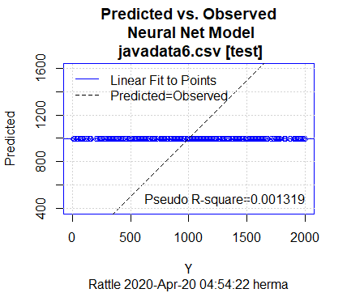
Results and Discussions
Neural Network Model performance on Dataset 6

Slide 29
Conclusions
There is evidence that machine learning algorithms can be used to predict values created by some pseudorandom number generators.
The C++ PRNG is predictable given the seed, but Python and Java PRNGs are not as predictable with or without the seed.

Slide 30
Conclusions
Reseeding before each random number generated is to be avoided, especially with C++.
The neural network performed no better than simple linear regression in most cases.

Slide 31
Future Work
Tests should be performed on other PRNGs to further confirm the results of this thesis.
With and without reseeding
Other C++ PRNGs
Tests should be performed using more sophisticated ML algorithms such as deep learning and recurrence algorithms.
Larger amount of data should be used in the training.

Slide 32
The End
Thank you

